Slide 1
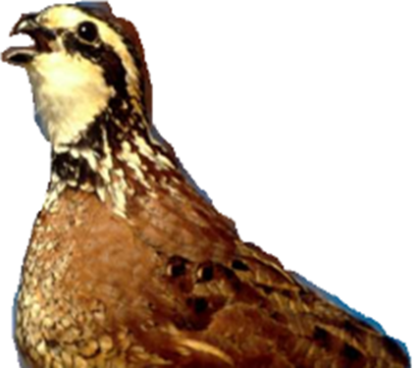
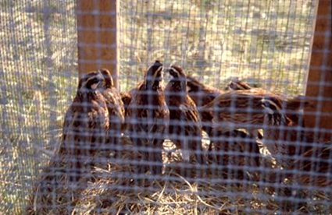
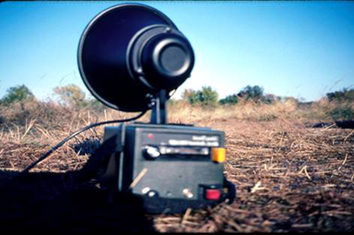
Simulation/Training Bobwhite Fall Covey Calling Counts
Instructions for setting up electronic callers
National Bobwhite Conservation Initiative
Tom Dailey, Science Coordinator
Kanopolis State Park, Kansas, October 6-7 2015

Slide 2
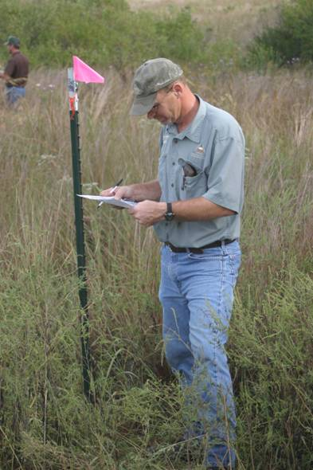
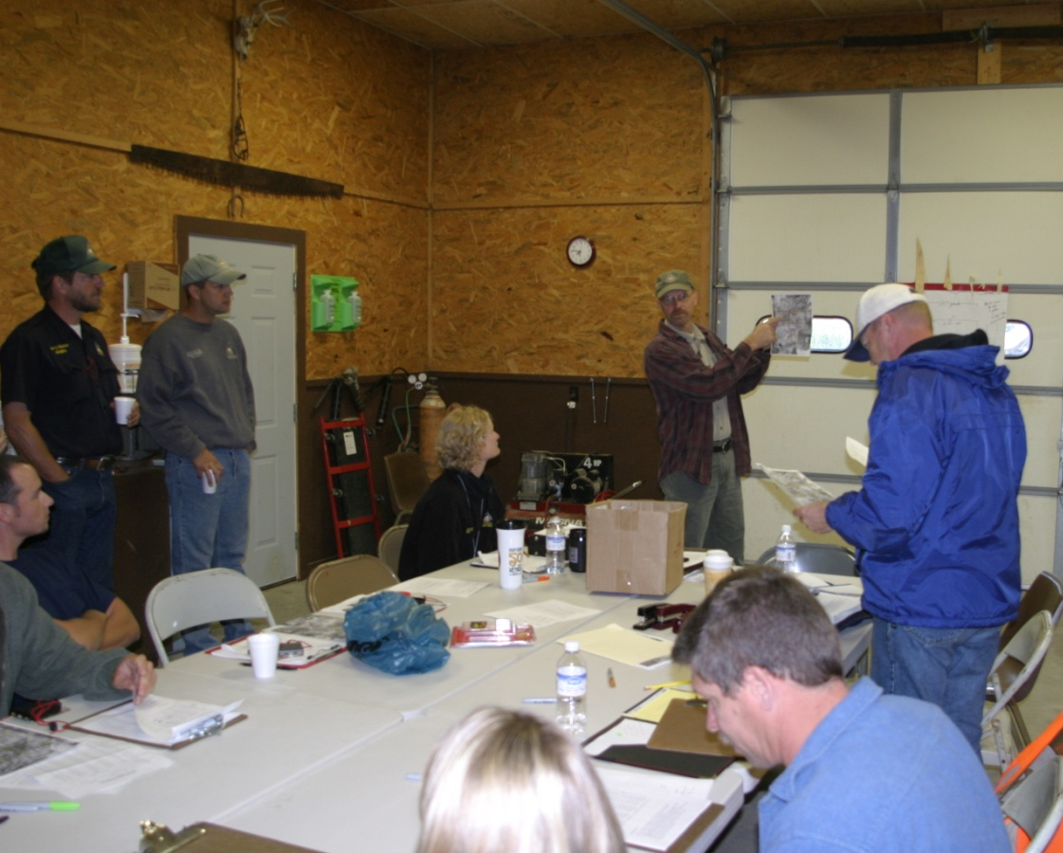

Need:
Classroom for PowerPoint (low light)
Close-by vegetated field for training using electronic callers (ca. 10)
Close by plentiful wild bobwhites (if during calling season, Sep-Nov)
Overnight lodging
Vegetation too short
Notes:
Prior to the calling period (sept-nov), training is conducted using simulated calling coveys, electronic callers.

Slide 3
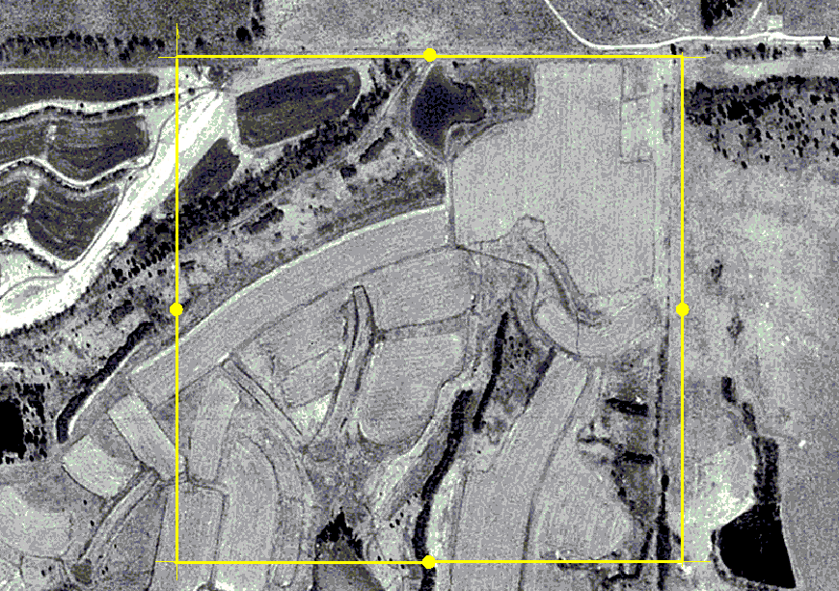
Select an area 500x500 m
25 ha
(62 ac)
Observers/T-post at center of each side
500 m
Notes:
Select an area of varying topography, woods, open, standing corn, etc.
Easy driving around/rotating among listening stations/t-posts important to quick training.
If these t-posts are used for pre-dawn wild bobwhite observations, make sure they have REFLECTIVE TAPE.

Slide 4


Simulated Calling Location
Select training area with little extraneous noise
  avoid any kind of engine noise
    Airport
    Bus route
    Highway
    Farmer
Away from farms, grain dryers, cattle, etc.
Away from captive quail
12-48 inch high veg to hide game callers—soybean harvest or prescribed fire can quickly render a training area useless

Slide 5
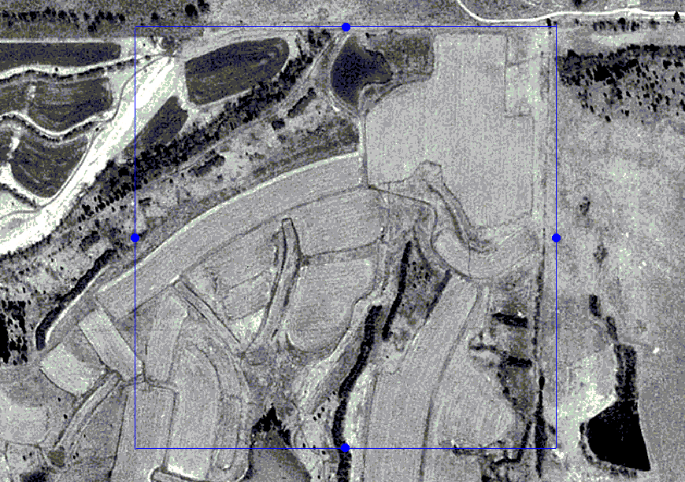


Notes:
The advantage of simulation with electronic callers is that training is not dependent on wild bobwhites, e.g., convenience, review, known caller locations.
The simulation/training field is best if no bobwhites (wild or captive) exist. The advantage of simulated calling (electronic) is KNOWN calling locations, so live birds can create confusion. However, wild birds are usually not stimulated to call during the day, so this is not a major concern.
It’s acceptable to use same field for simulation and wild bird observations.

Slide 6

Have a strategy for locations of electronic callers
Notes:
With trainees rotating among 4 listening stations, observations of the same electronic caller can be made from different perspectives.
Although this can be confusing, an observer hearing 10 or more coveys calling, >1 bird calling per covey, within a 1-2 minute time span can also be confusing.
Use ArcGis to create the training cell AND electronic caller locations. Use this to create 2 maps—one without caller locations and one with locations. For each training group (1-4), one leader has the map with electronic caller locations and this is used for discussion—but only to clear up any confusion at the first station visited. At the end, when groups convene for review, caller locations will be displayed on a large aerial photo (best if prepared ahead of time; but can also edit in field).
Use GPS to place electronic callers in the field (helps prevent loss of callers ☺).

Slide 7

Caller Locations Strategy
Game caller locations & volume need to be set for specific needs:
Research shows fall calling bobwhites can often be heard 500-meters away or more:
  But it is more important to practice shorter distances, far less than 500 m
Set-up requires 2-3 people to test & adjust volume & locations.
Place 2 speakers 30-m apart & about perpendicular to 1 observer >2 speakers 30-m apart & in-line for 2 of the observer listening stations
Place speakers to simulate echo effect of woods, topography, rustling tree/corn leaves
Try 2 callers at same distance from one observer--in tall vegetation (corn, big bluestem, etc.) & 1 in short vegetation (soybeans, little bluestem, etc.)
ROT for speaker direction—face nearest listening station.
Ca. 10 electronic callers needed
Notes:
In Distance Sampling, a proportion of longer distances are NOT USED in the analysis, so don’t dwell on extreme distances.

Slide 8

D.
A.
C.
B.
Notes:
With trainees rotating among 4 listening stations, observations of the same electronic caller can be made from different perspectives.
From listening station on left side, place 2 callers at same distance, but only 30 meters from each other.
Line 2-3 callers up between 2 adjacent listening stations.
Observers have to listen in a 360 arc; caller close to one listening station, and also detectable from other station(s).
Observations at closer distances (<500 meters) are more important than >500 meters; try to fool observer with 2 callers at same distance, one in thick/tall vegetation, and other in short & thin vegetation.
ROT, face all speakers in direction of nearest listening station.
Although this can be confusing, an observer hearing 10 or more coveys calling, >1 bird calling per covey, within a 1-2 minute time span can also be confusing.

Slide 9
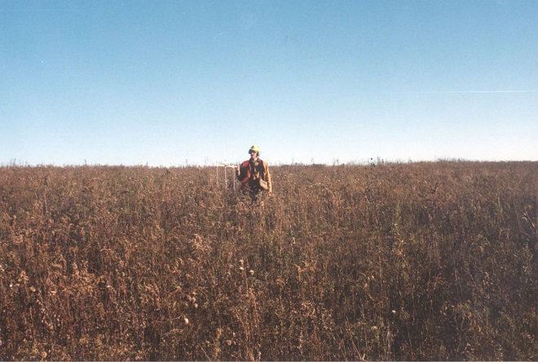
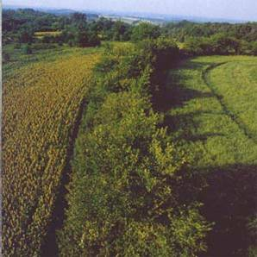
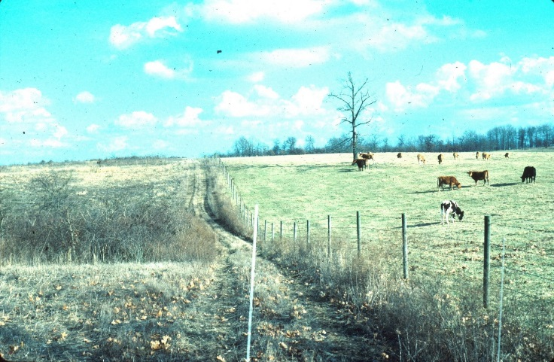
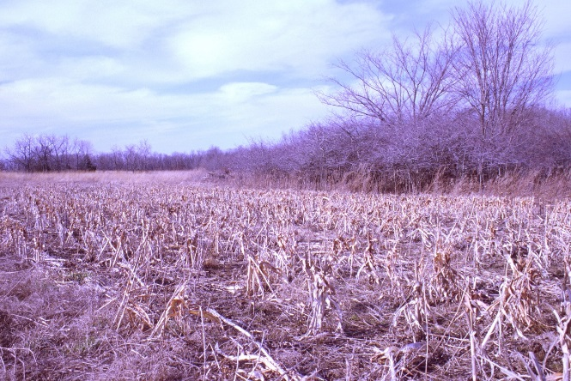
Where to hide electronic callers
If you want to simulate wild bobwhite roosting locations/habitat…
  Do Not put callers in woods, brush thickets, bare pasture/field
  Do put callers in herbaceous cover

Slide 10
Quail Roost Sites
Blind Pony Lake Conservation Area, MO
1995-96: 166 winter roosts
% of Roosts
GRASS/FORBS/SPROUTS
FORBS/GRASS
Notes:
These data are across winter, and thus, relative to October, there is more use of hard woody cover due to winter weather and hunting pressure (there is no daily time limit for quail hunting in MO).
Quail almost always roost in open-land habitats, fields of weeds, grass or crops. In this study, the old fields have perennial weeds (golden rod), grass, and a small amount of shrubs or woody sprouts. ESV is early-successional vegetation, typically 1-year old fallow crop fields—mostly annual weeds, like ragweed and foxtail. NWSG are native warm-season grasses, and CSG are cool-season grasses, like timothy, red top and orchard grass. Crop includes corn, soybeans and milo.
At blind pony many, many quail roosted in the fields dominated by golden rod, annual lespedeza, ragweed, grasses and shrubs. Some of the popularity of old fields results from the fact that this habitat type is everywhere at Blind Pony.

Slide 11
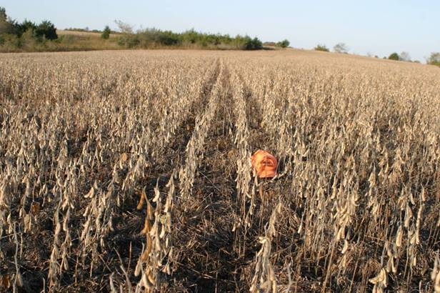
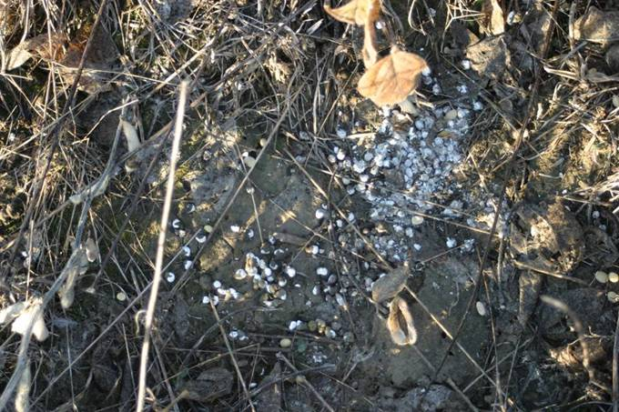
Crops, standing or stubble, are roosting habitat in fall
Detection of bobwhite calling can change overnight with harvest of corn
Whetstone fall 2007 roost in short beans

Slide 12
Training Day
Divide observers among 4 listening stations

Slide 13
Divide into 4 groups
Stand at the mark at the center of each side
Rotate clockwise from side-to-side

Slide 14
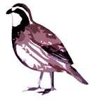
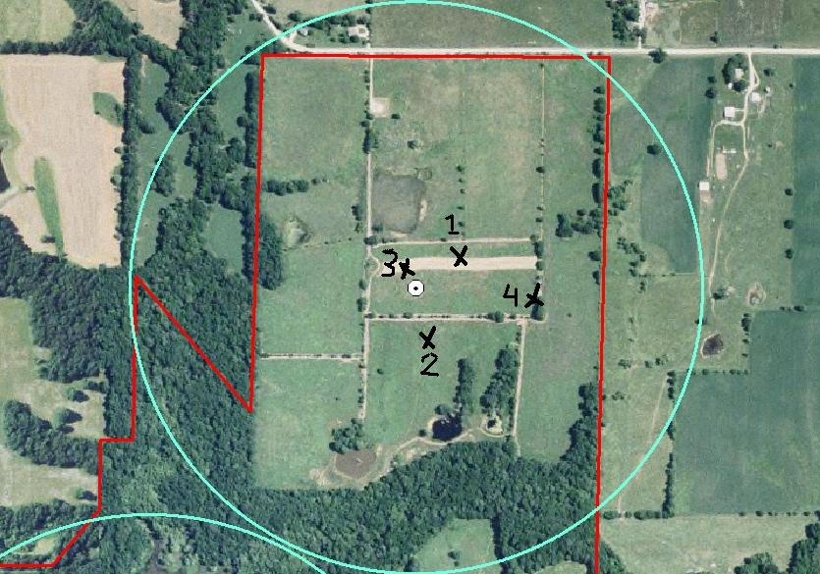
TRAINEES
Put bird location on DOQ
Estimate number of coveys heard

Slide 15
Working Around the Cell
Callers will be playing when you arrive at each station (or started with remote)—do 5-minute observation, followed by 5 min of discussion
One person is leader, keeping on time and moving to next stop
Spread out at listening post and work independently
After 4th post, meet-up for final discussion

